Slide 1

Lifestyle Medicine:
Nutrition
Professionals in Training

Slide 2

Contributors
Author:
Elizabeth Pegg Frates, MD
Assistant Professor, Part Time, Harvard Medical School (HMS)
Faculty, Psych E 1037-Introduction to Lifestyle Medicine
Harvard Extension School
Founder and Faculty Advisor, Lifestyle Medicine Interest Group at HMS
Board Liaison for Professionals in Training (PiT),
American College of Lifestyle Medicine (ACLM)
Editors:
Jonathan Bonnet, MD, CAQSM Kate Simeon, MD
Past ACLM Board Member Teaching Assistant
Past ACLM PiT Co-President Harvard Extension School
jbonnet@hsph.harvard.edu Pysch E 1037-
Introduction to Lifestyle Medicine

Slide 3


There is constant updating in nutrition science.
US Dietary Guidelines are reviewed every 5 years-2015 most recent
  Based on the most recent scientific evidence review
Many suggestions remain constant
Some are changed due to new research and understanding of nutrients, food, and behavior.
Notes:
U.S. Department of Agriculture and U.S. Department of Health and Human Services. Dietary Guidelines for Americans, 2010. 7th Edition, Washington, DC: U.S. Government Printing Office, December 2010

Slide 4
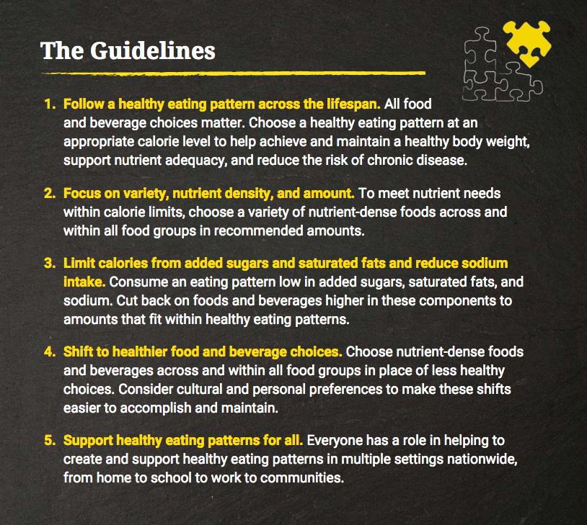
2015 Dietary Guidelines
U.S. Department of Health and Human Services and U.S. Department of Agriculture. 2015 – 2020. Dietary Guidelines for Americans. 8th Edition. December 2015. Available at http://health.gov/dietaryguidelines/2015/guidelines/.
Notes:
U.S. Department of Health and Human Services and U.S. Department of Agriculture. 2015 – 2020. Dietary Guidelines for Americans. 8th Edition. December 2015. Available at http://health.gov/dietaryguidelines/2015/guidelines/.

Slide 5
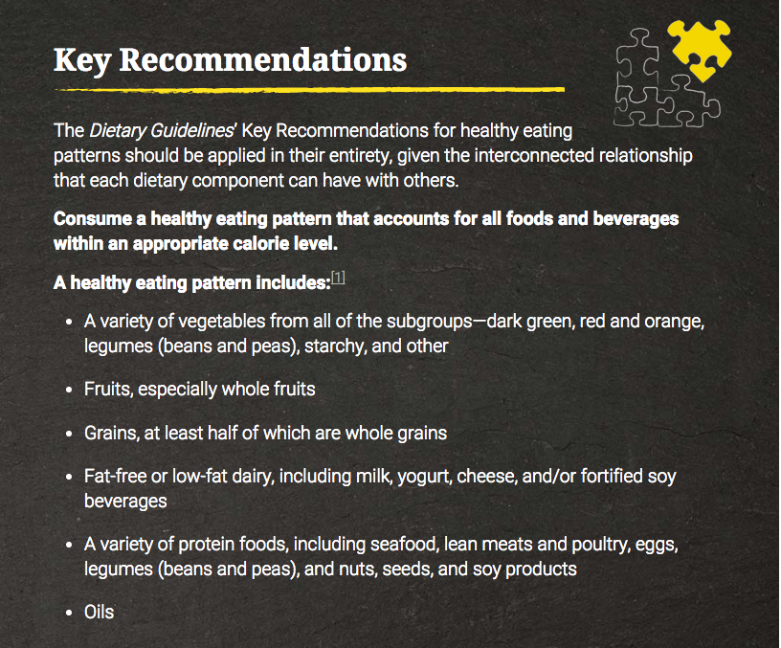
U.S. Department of Health and Human Services and U.S. Department of Agriculture. 2015 – 2020. Dietary Guidelines for Americans. 8th Edition. December 2015. Available at http://health.gov/dietaryguidelines/2015/guidelines/.

Slide 6

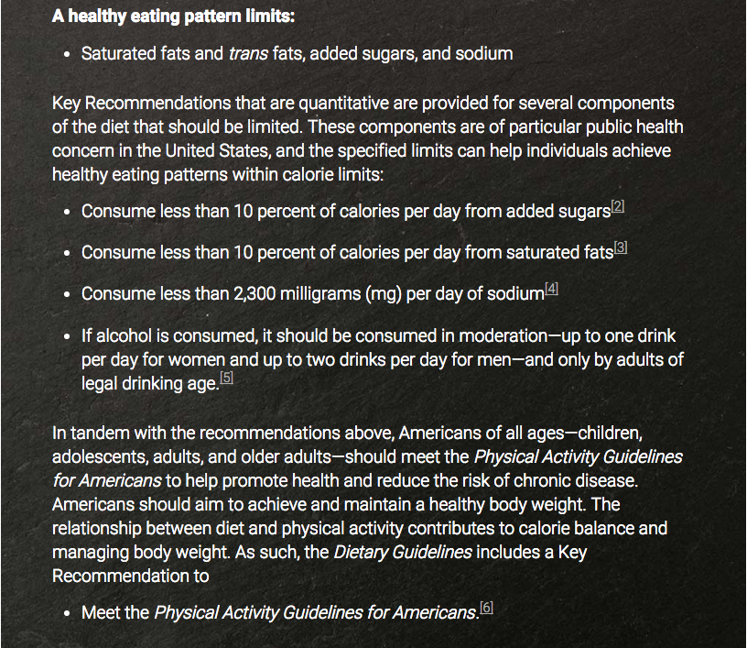
U.S. Department of Health and Human Services and U.S. Department of Agriculture. 2015 – 2020. Dietary Guidelines for Americans. 8th Edition. December 2015. Available at http://health.gov/dietaryguidelines/2015/guidelines/.

Slide 7
2015 Dietary Guidelines
Controversy Does Exist…
Concern that the finalized guidelines are “watered down” from the US Dietary Guidelines Advising Committee’s (DGAC) initial literature review and recommendations
Specifically:
    DGAC made stronger recommendations against consuming sugar-sweetened beverages and red/processed meat
    DGAC had commented on the sustainability (i.e. environment and planet) of the food recommendations, and this was omitted in the final report
Remember, guidelines are just that…guidelines
Notes:
Solid fats and added sugars (SoFAS) are also known as empty calories. Thirty-five percent of the average American's daily caloric intake—nearly 800 calories a day—is empty calories. Many people eat those calories in place of nutrient-rich foods their body needs.

Slide 8

2010 Dietary Guidelines
Two Overarching Themes:
Maintain calorie balance over time to achieve and sustain a healthy weight.
Focus on consuming nutrient-dense foods and beverages.

Slide 9
2010 Dietary Guidelines
Food and Food Components to Reduce
Daily sodium to less than 2300mg. Less than 1500mg for high risk.
Less than 10% calories from saturated fats.
Less than 300mg per day cholesterol.
Keep trans fat consumption as low as possible.
Reduce calories from SoFAS.
Limit consumption of refined grains.
If alcohol is consumed, do so in moderation.
Notes:
Solid fats and added sugars (SoFAS) are also known as empty calories. Thirty-five percent of the average American's daily caloric intake—nearly 800 calories a day—is empty calories. Many people eat those calories in place of nutrient-rich foods their body needs.

Slide 10
2010 Dietary Guidelines
Food and Nutrients to Increase
Fruits & Vegetables
Variety—dark green, orange, beans, peas.
At least half of grains as whole grains.
Fat-free and low-fat milk products.
Variety protein—seafood, lean meat, poultry, beans, peas, soy, eggs, unsalted nuts, and seeds.
Replace proteins high in solid fat with more healthful choices.

Slide 11
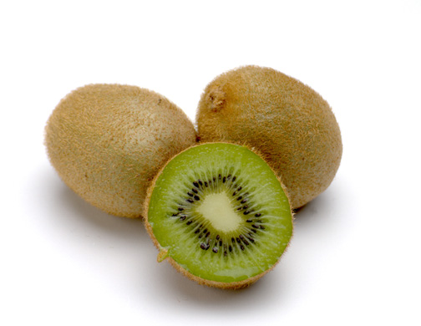
2010 Dietary Guidelines
Food and Nutrients to Increase (continued)
Use oils to replace solid fats
Choose foods with more potassium, fiber, calcium, vitamin D (nutrients of concern).
  Vegetables, fruits, whole grains, milk and milk products.

Slide 12
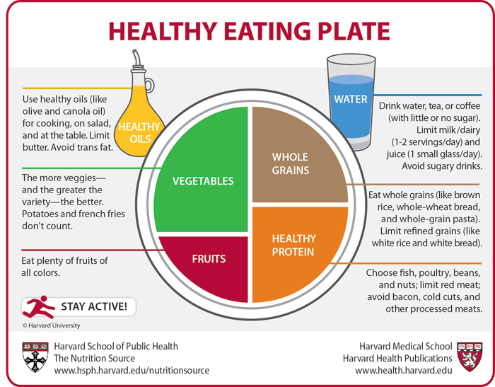
Copyright © 2011, Harvard University. For more information about The Healthy Eating Plate, please see The Nutrition Source, Department of Nutrition, Harvard School of Public Health, www.thenutritionsource.org, and Harvard Health Publications, www.health.harvard.edu.
Notes:
Water
Egger Chapter Fluids
Copyright © 2011, Harvard University. For more information about The Healthy Eating Plate, please see The Nutrition Source, Department of Nutrition, Harvard School of Public Health, www.thenutritionsource.org, and Harvard Health Publications, www.health.harvard.edu.

Slide 13
Findings on Carbohydrates (CHO) and Disease
High CHO (refined) can raise triglycerides and reduce HDL.
Higher intakes of refined starches and sugar (low fiber intake), increased risk of Diabetes.
Higher intake of fiber from grain products, are associated with lower risks of CHD and diabetes.
Willett WC, Stampfer MJ. Current Evidence on healthy eating. Annu Rev Public Health. 2013;34-77-95.

Slide 14
Findings on CHO and Fat on lipids.
Substituting CHO for saturated fat reduces HDL.
Substituting monounsaturated fat for saturated fat reduces LDL without affecting HDL.
Monounsaturated fats, compared with CHO, reduce blood sugar and triglycerides in diabetics.
Willett WC, Stampfer MJ. Current Evidence on healthy eating. Annu Rev Public Health. 2013;34-77-95.

Slide 15
Findings on Fat and CHD
Trans-fatty acids increase LDL and decrease HDL, and increase inflammatory markers.
Trans-fatty intake correlates with CHD.
Replacing saturated fat with polyunsaturated fat has reduced incidence of CHD.
Omega 3 fatty acids help to reduce fatal arrhythmias.
Willett WC, Stampfer MJ. Current Evidence on healthy eating. Annu Rev Public Health. 2013;34-77-95.

Slide 16

Findings on Red Meat and Disease
Intake of red meat, particularly processed meat has been associated with increased risk of diabetes.
Low fat vs low carb for weight loss, low carb was better in DIRECT trial.
Lowering intake of red meat will likely decrease the incidence of CHD, diabetes, colon cancer, and possibly premenopausal breast cancer.
Willett WC, Stampfer MJ. Current Evidence on healthy eating. Annu Rev Public Health. 2013;34-77-95.

Slide 17
Findings on Red Meat, Protein, Fats and Nuts on CHD.
Positive relationship between CHD and a higher consumption of red meat, compared with the same number of servings of fish, poultry, or nuts, and risk of CHD.
Substituting protein or monounsaturated fat for CHO reduces blood pressure and improves lipids and has been associated with lower risks of CHD.
  Fish (Omega 3)
Regular consumption of nuts associated with lower risk of CHD and type 2 Diabetes.
Willett WC, Stampfer MJ. Current Evidence on healthy eating. Annu Rev Public Health. 2013;34-77-95.

Slide 18
Findings for Salt and Fruits/Veggies
Excess salt is “irrefutably” linked to high blood pressure.
Higher fruit and vegetable intake has benefit in cardiovascular disease.
Willett WC, Stampfer MJ. Current Evidence on healthy eating. Annu Rev Public Health. 2013;34-77-95.

Slide 19
Findings Dairy products
High intake of calcium may increase risk of prostate cancer.
Calcium and dairy product consumption is associated with a low risk of coon cancer.
  Benefits at level of 800 mg per day
Willett WC, Stampfer MJ. Current Evidence on healthy eating. Annu Rev Public Health. 2013;34-77-95.

Slide 20
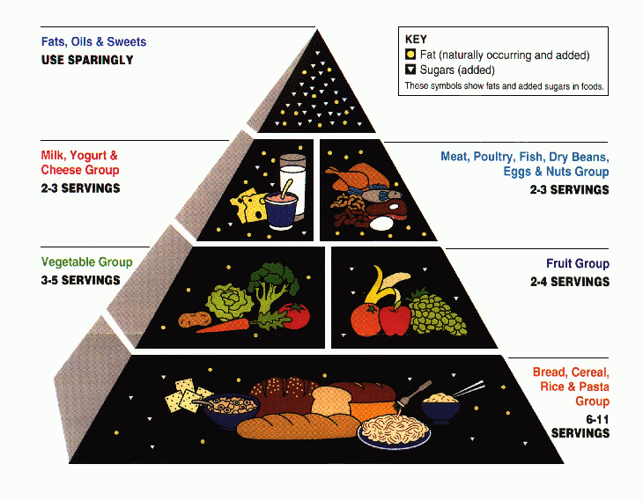
1992 Food Pyramid
http://fnic.nal.usda.gov/dietary-guidance/myplate-and-historical-food-pyramid-resources/past-food-pyramid-materials

Slide 21
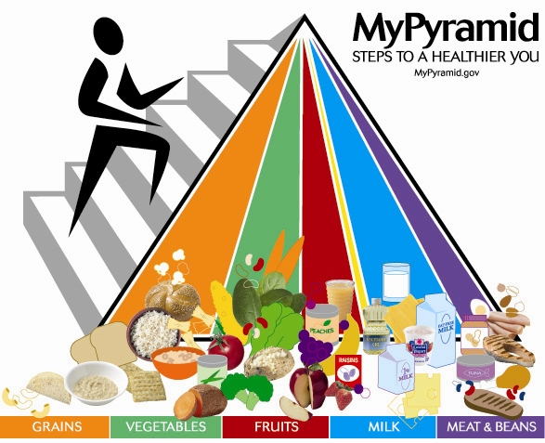
2005 Food Pyramid
http://www.foodpyramid.com/mypyramid/

Slide 22

2011 Healthy Plate
http://www.choosemyplate.gov/

Slide 23
2011 Harvard Healthy Plate
https://www.hsph.harvard.edu/nutritionsource/healthy-eating-plate/

Slide 24
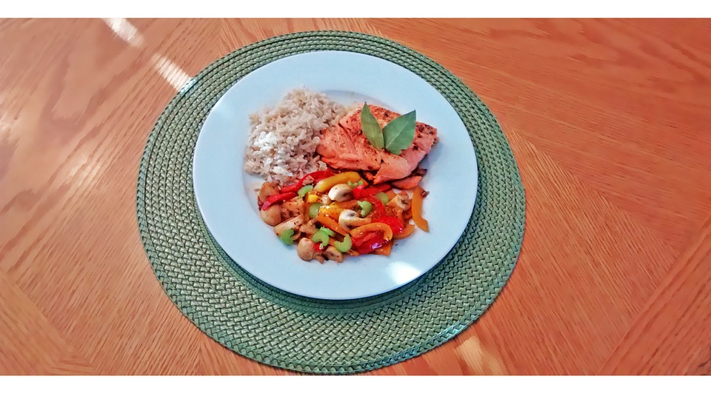
Healthy Plate
https://pixabay.com/en/plate-cook-gastronomy-meals-health-604423/
Notes:
https://pixabay.com/en/plate-cook-gastronomy-meals-health-604423/

Slide 25
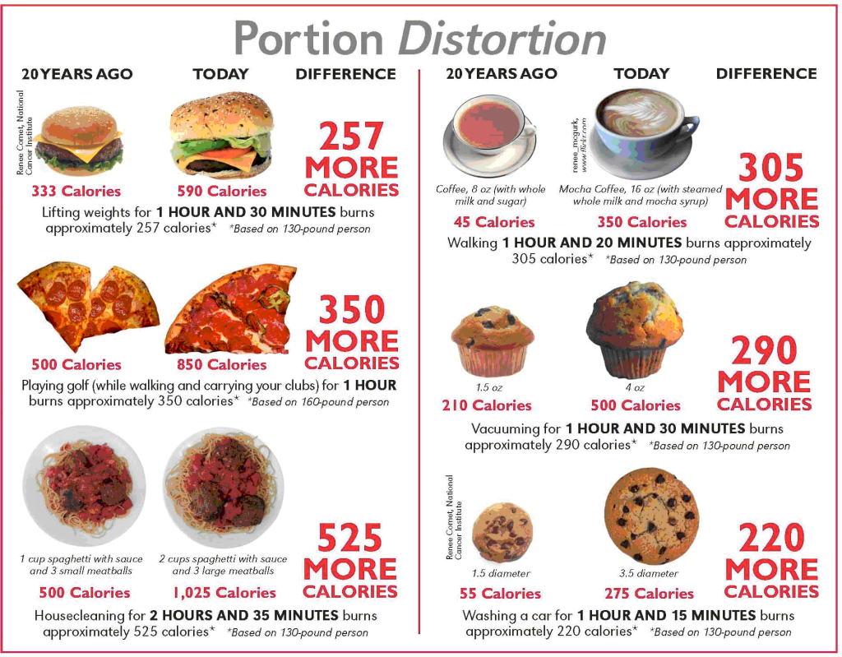
Portion Distortion
https://www.fitmapped.com/blog/wp-content/uploads/2013/09/truth-about-portion-distortion-1024x799.png

Slide 26
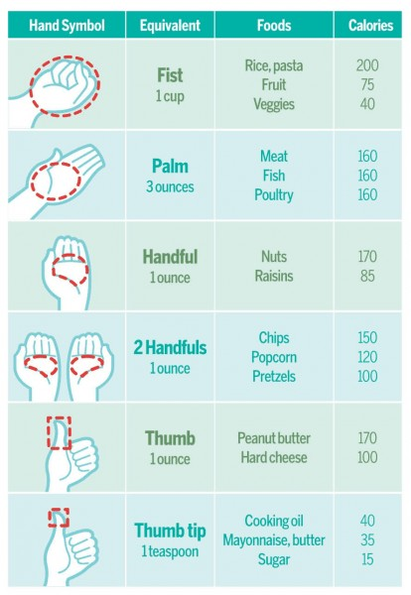
Portions
https://www.fitmapped.com/blog/wp-content/uploads/2013/09/portion_control_chartFULL1-11-414x600.jpg

Slide 27
Satiety
Hormones
  Hypothalamus
    Hormonal Regulators of Appetite
    http://www.ncbi.nlm.nih.gov/pmc/articles/PMC2777281/#!po=10.4167
  Ghrelin- appetite increaser (increases with lack of sleep) made in stomach and signals to the brain that you are hungry
  Leptin- appetite suppresser which is made in fat cells
Time
  It takes about 20 minutes to feel full
  Eating at regular times (3 times a day with 2 snacks) to keep blood glucose steady
Distention-water and fiber
  Full Plate Diet (available free on line)
  Filling up with fiber rich, nutrient rich foods
Sugar Cycle

Slide 28
Top Five Fruits
Raspberries/Blackberries
  Vitamin C, Folate, Anthocyanin pigments
    Anti-oxidant, anti-inflammatory
Pears
  Vitamin A, Vitamin C,
Apples
  Quercetin, fiber
Oranges
  Herperidin, flavinoids, limonoids, over 170 phytonutrients
Bananas
  Potassium, Vitamin B6, stimulates production of serotonin,
Seale SA, Sherard T, Fleming D.(2009). The Full Plate Diet: Slim Down, Look Great, Be Health!. Austin, TX:Bard Press.

Slide 29
Top Five Vegetables
Avocado
  Monounsaturated fats, folate, Vitamins E,K, and B, Potassium
Broccoli
  Vitamin C, Beta Carotene, assists in making thyroxin, enhancing absorption of iron
Spinach (most nutrients per calorie)
  Lutein and iron
Sweet potatoes
  Potassium, iron, manganese, copper, quercitin, cholorogenic acid
Carrots
  Beta carotene, calcium pectate (soluble fiber that helps remove LDL)
Seale SA, Sherard T, Fleming D.(2009). The Full Plate Diet: Slim Down, Look Great, Be Health!. Austin, TX:Bard Press.
Notes:
Technically Avocado is a fruit (because it has seeds), however many times it is associated with vegetables.

Slide 30
Calories
Measures the energy in food
The amount of heat required to raise the temperature of one kilogram of water one degree Celsius.
  Merriam Webster Dictionary
Protein 1 gram
  4 calories
Carbohydrates 1 gram
  4 calories
Fat 1 gram
  9 calories
Alcohol
  7 calories

Slide 31
The number of calories used
The basal metabolic rate (BMR)
Physical activity during the day
The thermic effect of food (TEE)

Slide 32
Basal Metabolic Rate (BMR)
The amount of energy your body uses at rest for bodily functions such as breathing, your heart beating, your kidneys filtering sodium, your hair growing and other functions of vital organs.
Also called the Resting Energy Expenditure
  REE

Slide 33
Calculating the BMR- Quick Estimate
Men
  1.0 X weight in kilograms X 24 hours in a day
Women
  0.9 X weight in kilograms X 24 hours in a day
Example (1 kg=2.2 pounds)
200 pound man has a BMR of 2182
  200 pounds/2.2 = 90.91 kg
  1.0 X 90.91 X 24 hours per day= 2182.8 calories a day

Slide 34
Your BMR
Grab a calculator (or your phone) and let’s calculate your BMR….

Slide 35
Harris-Benedict Equation for Calculating BMR with weight and height
For men
  66.6 + (13.7 X wt in kg) + (5 X ht in cm) – (6.7 X age in years) = BMR
For women
  655.1 + (9.6 X wt in kg) + (1.8 X ht in cm) – (4.7 X age in years) = BMR
    1 kg = 2.2 pounds and 1 inch = 2.54 cm
Notes:
The Harris Benedict Equation is a formula that uses your BMR and then applies an activity factor to determine your total daily energy expenditure (calories). The only factor omitted by the Harris Benedict Equation is lean body mass. Remember, leaner bodies need more calories than less leaner ones. Therefore, this equation will be very accurate in all but the very muscular (will under-estimate calorie needs) and the very fat (will over-estimate calorie needs)

Slide 36
Calculating Average Number of Calories Burned in a Day
Physical Activity Level
Sedentary-very little to no exercise, sitting, sleeping, and reclining
  BMR X 20%
Very Light- some exercise 2 days a week or less and seated/standing activities
  BMR X 30%
Moderate-regular exercise 5 days a week and digging in the yard, carrying a load, tennis, cycling, skiing
  BMR X 40%
Heavy-regular heavy exercise 6 days a week + and heavy manual labor, climbing, basketball, soccer
  BMR X 50%

Slide 37
Thermic Effect of Food
Energy to digest food
  10% of total calories consumed
  For example if 500 calories are consumed, that uses 50 calories to digest

Slide 38
Calories needed in a day using Harris Benedict Equation
To calculate your total daily calorie needs find BMR and multiply by the appropriate factor given your activity level
If you are sedentary (little or no exercise) :
BMR x 1.2
If you are lightly active (light exercise/sports 1-3 days/week) :
BMR x 1.375
If you are moderately active (moderate exercise/sports 3-5 days/week) :
BMR x 1.55
If you are very active (hard exercise/sports 6-7 days a week) :
BMR x 1.725
If you are extra active (very hard exercise/sports & physical job or 2x training) :
BMR x 1.9

Slide 39
Resources
Websites:
Physician’s Committee for Responsible Medicine: http://www.pcrm.org/
NutritionFacts.org: http://www.nutritionfacts.org/
Complete Health Improvement Program (CHIP): https://www.chiphealth.com/
Ornish Program: http://ornishspectrum.com/
Books:
Disease-Proof: The Remarkable Truth about What Makes Us Well
  David Katz
How Not to Die
  Michael Greger, Gene Stone.
Prevent and Reverse Heart Disease
  Caldwell Esselstyn
The China Study
  T. Colin Campbell
The Spectrum
  Dean Ornish

Slide 40
Become Part of the LM Movement!
Join the American College of Lifestyle Medicine (ACLM) and connect with others passionate about LM!
  Plus, tons of additional membership benefits!
For trainees, we encourage you to become a Professional in Training (PiT) member and get involved in spreading LM to campuses nationwide!
  Lifestyle Medicine Interest Group (LMIG) Starter Kit and Introductory Video available online
www.lifestylemedicine.org
Notes:
Hyperlink 1: http://www.lifestylemedicine.org/Membership-Application
Hyperlink 2: http://www.lifestylemedicine.org/Membership-Benefits
Hyperlink 3: http://www.lifestylemedicine.org/Why-Join
Hyperlink 4: http://www.lifestylemedicine.org/INTEREST-GROUPS
Hyperlink 5: https://vimeo.com/143219257

Slide 41
Interested in Diving Deeper into LM and Advancing the Field?
There is a special award for Professionals in Training.
The Donald Anderson Pegg Award to help start your own LMIG at a medical school or to help spread LM in another health care related professional school.
Please go to the ACLM website for further information.
Teams of students can apply and attendings/mentors are encouraged to get involved as well.
www.lifestylemedicine.org
Notes:
Hyperlink 1 & 2: http://www.lifestylemedicine.org/Annual-Awards#DonaldAndersonPeggAwardforYoungLifestyleMedicineInnovators

Slide 42
Join Us!
The Lifestyle Medicine Conferences are a great way to get connected with other healthcare professionals that are passionate about improving the lives of others through lifestyle medicine!
Come connect with colleagues and hear from LM visionaries to learn about current, evidence-based LM practices.
LMConference.org
Notes:
Hyperlink 1: Lmconference.org

Slide 43
Special thanks…
…to the American College of Lifestyle Medicine and to ACLM’s Professionals in Training (PiT) for their support.

Slide 44
References
U.S. Department of Health and Human Services and U.S. Department of Agriculture. 2015 – 2020. Dietary Guidelines for Americans. 8th Edition. December 2015. Available at http://health.gov/dietaryguidelines/2015/guidelines/.
U.S. Department of Agriculture and U.S. Department of Health and Human Services. Dietary Guidelines for Americans, 2010. 7th Edition, Washington, DC: U.S. Government Printing Office, December 2010.
The Healthy Eating Plate. Copyright © 2011, Harvard University. For more information about The Healthy Eating Plate, please see The Nutrition Source, Department of Nutrition, Harvard School of Public Health, www.thenutritionsource.org, and Harvard Health Publications, www.health.harvard.edu.
Willett WC, Stampfer MJ. Current Evidence on healthy eating. Annu Rev Public Health. 2013;34-77-95.
U.S. Department of Agriculture National Agricultural Library. Past Food Pyramid Materials. http://fnic.nal.usda.gov/dietary-guidance/myplate-and-historical-food-pyramid-resources/past-food-pyramid-materials
U.S. Department of Agriculture National Agricultural library. Home. http://fnic.nal.usda.gov/
Seale SA, Sherard T, Fleming D.(2009). The Full Plate Diet: Slim Down, Look Great, Be Health!. Austin, TX:Bard Press.

