Slide 1

Lifestyle Medicine:
Exercise
Professionals in Training

Slide 2

Contributors
Author:
Elizabeth Pegg Frates, MD
Assistant Professor, Part Time, Harvard Medical School (HMS)
Faculty, Psych E 1037-Introduction to Lifestyle Medicine
Harvard Extension School
Founder and Faculty Advisor, Lifestyle Medicine Interest Group at HMS
Board Liaison for Professionals in Training (PiT),
American College of Lifestyle Medicine (ACLM)
Editors:
Jonathan Bonnet, MD, CAQSM Kate Simeon
Past ACLM Board Member Teaching Assistant
Past ACLM PiT Co-President Harvard Extension School
jbonnet@hsph.Harvard.edu Pysch E 1037-
Introduction to Lifestyle Medicine

Slide 3
Definitions
Physical Activity
Exercise
Physical activity is any bodily movement produced by skeletal muscles that results in an expenditure of energy.
Exercise is physical activity that is planned or structured. It involves repetitive bodily movement done to improve or maintain one or more of the components of physical fitness.
Centers for Disease Control, 2006

Slide 4
Physical Fitness
“Physical fitness is a set of attributes that people have or achieve that relates to the ability to perform physical activity.”
1) cardiorespiratory endurance (aerobic fitness):
2) muscular strength,
3) muscular endurance,
4) flexibility,
5) body composition.
    Center for Disease Control and Prevention

Slide 5
The Benefits of Exercise
MEDICAL MODEL
MENTAL HEALTH MODEL
Helps prevent cardiac disease and stroke
Reduces blood pressure
Controls blood glucose
Controls weight and helps prevent obesity
Helps prevent bone loss
Can increase self-esteem and energy, improve mood, and decrease stress.
Improve sleep
Increase interest in sex
Better endurance
Stress Relief
Improvement in mood
Increased energy and stamina
Reduced tiredness that can increase mental alertness
Weight reduction
Reduced Cholesterol and improved cardiovascular fitness
Sharma et al. Exercise for Mental Health. Prim Care Companion J Clin Psychiatry. 2006;8(2):106.
Hwang MY. Why you should exercise. JAMA. 1999;281(4).

Slide 6
Cognition
Exercise, brain, and cognition across the lifespan
  Beneficial in both childhood and adulthood
  Aerobic and resistance exercise helpful
Positive association between aerobic fitness and enhanced performance in both the classroom and laboratory
Improved memory-Hippocampus
Improved multi-tasking, planning and inhibition-pre-frontal cortex
“…there is ample evidence to support it (exercise) as one of the most effective means available to improve mental and physical health…”
Voss MW, et al. Exercise, brain, and cognition across the lifespan. J Appl Physiol 111:1505-1513,2011.

Slide 7

This sounds great!
Where do I start?

Slide 8
Physical Activity Risk Stratification
Low Risk
  Men under 45 and women under 55
  Asymptomatic
  No more than one risk factor
    Cleared for low, moderate, and vigorous activity
Moderate Risk
  Men over 45 and women over 55
  OR those who meet the criteria for two or more risk factors
    Cleared for low and moderate intensity activity and further evaluation is recommended for vigorous
High Risk
  Individuals with one or more signs or symptoms of cardiovascular disease, metabolic, or pulmonary disease
  Those with known cardiovascular, metabolic, or pulmonary disease
    Further evaluation is recommended prior to initiating physical activity
  ACSM’s Health-Related Physical Fitness Assessment Manual (2008) pages 15-20.

Slide 9
Risk Factors
ACSM’s Guide to Exercise Testing and Prescription (2009)
  Family History
  Current Cigarette Smoking
  Obesity
  Hypertension
  Hypercholesterolemia
  Pre-diabetes

Slide 10
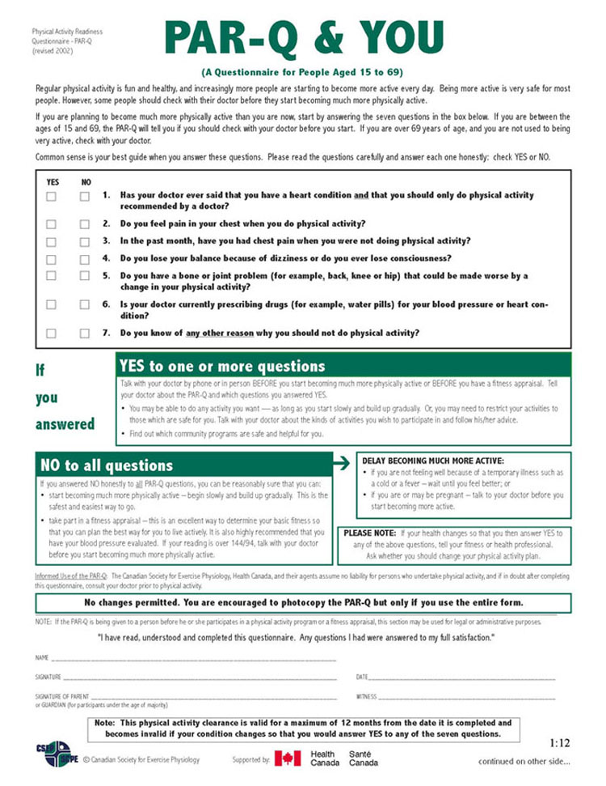
Physical Activity Readiness Questionnaire
http://www2.furman.edu

Slide 11

Sedentary Lifestyle as Risk Factor
The American Heart Association (1992) recognized “sedentary lifestyle” as a primary controllable cardiac risk factor. The prevalence of sedentary lifestyle is at least twice that of smoking, hypertension and elevated total serum cholesterol.
Notes:
sedentary behavior, which may be defined as sitting, lying down, and expending very little energy
(approximately 1.0-1.5 metabolic equivalents [METs]), and light-intensity activity, such as standing, self-care activities, and slow walking, which require low energy expenditure (approximately 1.6-2.9 METs)

Slide 12
Risks of Sedentary Behavior
- Reduced functional capacity
- Osteoporosis
- Obesity
- Anxiety and depression
- Hypertension
- Cardiovascular disease
- Colon cancer
Thromboembolic stroke
Breast cancer
Type 2 Diabetes
KESANIEMI et al. Med. Sci. Sport Exerc. 33(6 Suppl):S531–S538, 2001

Slide 13
Is sitting the new…..
Harvard Business Review Blog by Nilofer Merchant 1/14/13
“Excessive sitting is a lethal activity.”
Circulation article
  8,800 Australians
  Each additional hour of television watched per day translated to an 11% increase in all cause mortality.
Circulation.2010; 121: 384-391

Slide 14
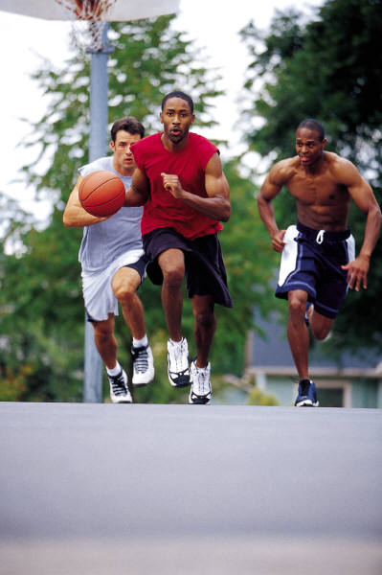
USHHS Physical Activity Guidelines for Americans: Adults
150 minutes of moderate intensity physical activity per week
or
75 minutes of vigorous physical activity per week
(In bouts of at least 10 minutes)
60 minutes per day for children
Notes:
Completed two year review of physical activity literature (~8,600 articles).
First Federal guidelines were released October 7, 2008
Background report completed
http://www.health.gov/PAguidelines
Here they are…
How many people have already seen these recommendations?
They are recommending that people ACCUMULATE 150 minutes of moderate intensity physical activity
150 minutes which is equivalent to two and a half hours.
You may be thinking this sounds a lot like the 1996 Surgeon General’s report
which recommended 30 minutes of exercise most days of the week.
30 times 5 is 150 so thirty minutes 5 days a week reaches this recommendation.
The difference is that US Health and Human Services recommendations provide
more flexibility and leeway for people to craft and create their own physical activity schedules.
They have also added another part to the recommendation which says that
Accumulating a shorter amount (75 minutes) of more intense exercise at a vigorous level is just as good.
The ACSM and the American Heart Association introduced this concept into their guidelines in 2007 as well.
The US Health and Human Services recommendations also make clear that more is better.
300 minutes or 5 hours of moderate intensity physical activity will provide more extensive health benefits.
Again there is the differentiation between the moderate level intensity and the vigorous level intensity.
Accumulating 150 minutes of vigorous intensity exercise will do more for you than accumulating 75 minutes each week.
Resistance training twice a week is also recommended.

Slide 15
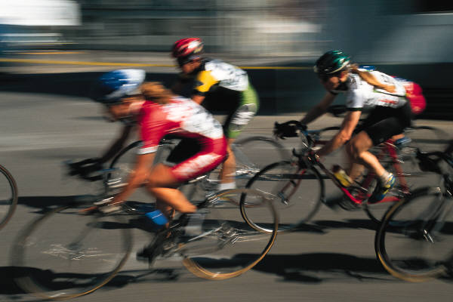
More Extensive Health Benefits
300 minutes of moderate
intensity physical activity
OR
150 minutes of vigorous
intensity physical activity

Slide 16
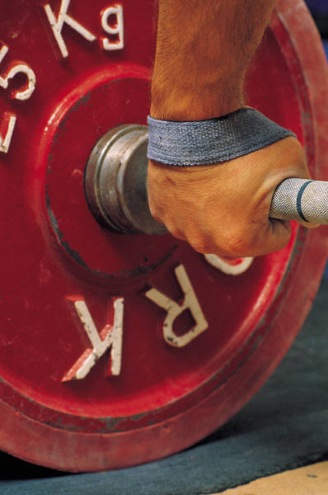
Strength Training Twice a Week on Nonconsecutive Days
All major muscle groups
2-4 sets
Repetition (reps) Ranges:
  8-12 reps for strength and power
  10-15 reps for middle-age and older persons starting to exercise
  15-20 reps for endurance
Notes:
Adults should train each major muscle group two or three days each week using a variety of exercises and equipment.Very light or light intensity is best for older persons or previously sedentary adults starting exercise.Two to four sets of each exercise will help adults improve strength and power.For each exercise, 8-12 repetitions improve strength and power, 10-15 repetitions improve strength in middle-age and older persons starting exercise, and 15-20 repetitions improve muscular endurance.Adults should wait at least 48 hours between resistance training sessions.

Slide 17
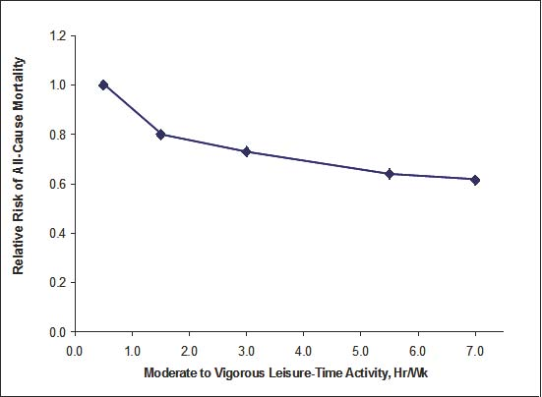
Exercise Frequency and Relative Risk of All Cause Mortality
Adapted from http://www.health.gov/PAguidelines in Jonas S, Phillips EM.
Exercise is Medicine™: A Clinician’s Guide to Exercise Prescription.
Philadelphia: Lippincott, Williams & Wilkins; 2009.
Notes:
This is a graph from the website www.health.gov/PAguidelines and
It is also featured in the ACSM’s textbook titled Exercise is Medicine which is due to be released in March
The graph itself is adapted from the Health and Human Services Physical Activity guidelines page 11.
According to this 638 page report,
Research clearly demonstrates the importance of avoiding physical inactivity and that
Small amounts of physical activity each week reduce the risk of dying prematurely.
It shows moderate to vigorous leisure time activity in hours per week on the x axis
And relative risk of all cause mortality on the y axis.
As you can see the sharpest point in the curve is from less than 30 minutes to 90 minutes.
The graph keeps steadily declining until we reach about 150 minutes.
If you look out to 300 minutes or 5 hours, the graph seems to taper off a little bit.
Hence, the upper limit for which to strive—300 minutes per week
Of moderate physical activity.

Slide 18
American Academy of Pediatrics Recommendations
Strength training programs for preadolescents and adolescents can be safe and effective if proper resistance training techniques and safety precautions are followed.
Preadolescents and adolescents should avoid competitive weight lifting, power lifting, body building, and maximal lifts until they reach physical and skeletal maturity.
Before beginning a formal strength training program, a medical evaluation should be performed by a pediatrician.

Slide 19
Flexibility
- At least two or three days each week to improve range of motion.
- Each stretch should be held for 10-30 seconds to the point of tightness or slight discomfort.
- Repeat each stretch two to four times, accumulating 60 seconds per stretch.
- Static, dynamic, ballistic and PNF (proprioceptive neuromuscular facilitation) stretches are all effective.
- Flexibility exercise is most effective when the muscle is warm. Try light aerobic activity or a hot bath to warm the muscles before stretching.
From ACSM at acsm.org

Slide 20
Exercise Progression
Start low and go slow
“Gradual progression of exercise time, frequency and intensity is recommended for best adherence and least injury risk.” (ACSM)
To Lose Weight:
30-60 minutes of moderate intensity physical activity a day
Frequent activity over long periods of time at low intensity will bring benefits for weight loss and health.
To Maintain Weight Loss
60-90 minutes of moderate intensity physical activity per day

Slide 21
There are four parts of the exercise prescription…
F: Frequency- how often?
I: Intensity- how hard?
T: Time- how long?
T: Type- what?
Notes:
Here is a helpful mnemonic to recall the 4 basic parts of the
Exercise prescription.

Slide 22
F.I.T.T.
Frequency: number of sessions or workouts
  Ex. I will walk 3 times per week
Intensity: difficulty of the exercise
  Ex. I will walk at a moderate intensity, such that I will be able to talk, but not be able to sing
      More on intensity in upcoming slides
Time: number of minutes of activity
  Ex. I will walk for 30 minutes during each session
Type: choice of activity to engage in
  Ex. I will swim…, I will bike…, I will walk…, etc.

Slide 23
Intensity Using Heart Rate
Maximum Heart Rate = 220 – Age (in years)*
    Very light = <50 % of maximal heart rate
    Light = 50-63 % of maximal heart rate
    Moderate = 64-76 % of maximal heart rate
    Vigorous = 77-93 % of maximal heart rate
    Very Hard = >94 % of maximal heart rate
    Maximal = 100% of maximal heart rate
*Maximal Heart Rate calculation is not accurate in the elderly or in people taking a beta-blocker
Notes:
Based on the maximal heart rate, you can figure out the target heart rate for various intensity levels.
We are focusing on the light, moderate and vigorous ranges.
50%-63% of maximal heart rate corresponds to light work.
64% to 76% of maximal heart rate corresponds to moderate work.
77% to 93% of maximal heart rate corresponds to vigorous load.
In general this heart rate method not recommended for cardiac patients.
For one many are on beta blockers which blunts the cardiac response.
Often their maximal heart rate is best calculated with an exercise stress test.
Since cardiac patients fall into the high risk category they are going to require further medical clearance and more extensive evaluation prior to prescribing an exercise prescription.

Slide 24
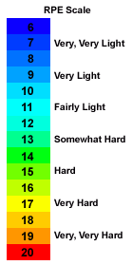
Borg Scale of Perceived Exertion
Used in all cardiac rehab centers
RPE Scale, G. Borg, 1998

Slide 25

Intensity Using the Sing Test
Sing Test
  Low intensity
    You can sing while exercising.
  Moderate intensity
    You can easily talk while exercising but not sing.
  Vigorous intensity
    It is difficult to talk while exercising.
Notes:
This is where the sing test comes in.
We are getting less and less scientific as we progress here.
This is a simple test for intensity.
If you can sing while you are exercising, then you must not be working too hard and you must be at a low intensity level.
If you can talk while you exercise but you can not sing, then you must be at a moderate intensity.
If you are so winded that you can not even talk, you are working really hard and that must correlate to a vigorous level.

Slide 26

Lifestyle Exercise
Taking the stairs
Parking in a space far from store
Bicycling to work
Walking during your lunch break
Walking your dog
Walking to the train or bus stop
Raking the leaves
Vacuuming the house
Notes:
Here is another question-
What type of exercise can you do with a friend?
What type of exercise fits your lifestyle?
I have often considered bringing my sons’ hippity hops into work
And seeing if Dr. Phillips, the Director of the ILM would hold a meeting
With me while we hippity hopped.
He might be game you never know.
During our last meeting, we did discuss meeting and walking around the block
Instead of sitting.

Slide 27
SMART Goals
S = Specific
M = Measurable
A = Action oriented
R = Realistic
T = Time sensitive
Example:
“By February 1, I will walk for 30 minutes at least three days per week.”

Slide 28
What are the aerobic physical activity guidelines for adults?
90 minutes of vigorous exercise per week
150 minutes of moderate intensity exercise per week
150 minutes of vigorous intensity exercise per week
150 minutes of vigorous intensity exercise per day
Notes:
B) 150 minutes of moderate intensity exercise per week (or 75 minutes of vigorous intensity exercise)

Slide 29
What are the CDC components of physical fitness? (Check all that apply)
Muscular Strength
Cardiorespiratory Fitness
Body Composition
Muscular Endurance
Flexibility
Notes:
All of the above!
A, B, C, D, E are all components of physical fitness.

Slide 30
What is a SMART Goal?
Specific, Measurable, Appropriate, Realistic, Timely
Specific, Meaningful, Appropriate, Realistic, Timely
Specific, Meaningful, Action Oriented, Realistic, Time Sensitive
Specific, Measurable, Action Oriented, Realistic, Time Sensitive
Notes:
D) Specific, Measurable, Action Oriented, Realistic, Time Sensitive

Slide 31
Is this a SMART Goal or Not?
“I want to lose 20 pounds by Spring Break.”
Notes:
No. Although this is a measurable goal, it is not a SMART goal. Losing weight is nonspecific, as there are many ways to lose weight and we are looking for specific, action oriented plans. Weight is an outcome, not something you can directly control, per se. Even if you exercised more and ate better, your weight may not change as one might expect. 20 pounds could be realistic if it is over a long enough time frame, but it would take a few months for most people.

Slide 32
Is this a SMART Goal or Not?
“I will go for a 60 minute walk after dinner at least 3 days per week by March 1st.”
Notes:
Yes, the goal is very specific, measurable, action oriented (one can control exercise time, but not their weight necessarily), realistic, and time sensitive (by March 1st)

Slide 33
Become Part of the LM Movement!
Join the American College of Lifestyle Medicine (ACLM) and connect with others passionate about LM!
  Plus, tons of additional membership benefits!
For trainees, we encourage you to become a Professional in Training (PiT) member and get involved in spreading LM to campuses nationwide!
  Lifestyle Medicine Interest Group (LMIG) Starter Kit and Introductory Video available online
www.lifestylemedicine.org
Notes:
Hyperlink 1: http://www.lifestylemedicine.org/Membership-Application
Hyperlink 2: http://www.lifestylemedicine.org/Membership-Benefits
Hyperlink 3: http://www.lifestylemedicine.org/Why-Join
Hyperlink 4: http://www.lifestylemedicine.org/INTEREST-GROUPS
Hyperlink 5: https://vimeo.com/143219257

Slide 34
Interested in Diving Deeper into LM and Advancing the Field?
There is a special award for Professionals in Training.
The Donald Anderson Pegg Award for innovative research and inspiring projects in LM.
Please go to the ACLM website for further information.
Teams of students can apply and attendings/mentors are encouraged to get involved, as well.
www.lifestylemedicine.org
Notes:
Hyperlink 1 & 2: http://www.lifestylemedicine.org/Annual-Awards#DonaldAndersonPeggAwardforYoungLifestyleMedicineInnovators

Slide 35
Join Us!
The Lifestyle Medicine Conferences are a great way to get connected with other healthcare professionals that are passionate about improving the lives of others through lifestyle medicine!
Come connect with colleagues and hear from LM visionaries to learn about current, evidence-based LM practices.
LMConference.org
Notes:
Hyperlink 1: lmconference.org

Slide 36
Special thanks…
…to the American College of Lifestyle Medicine and to ACLM’s Professionals in Training (PiT) for their support.

Slide 37
References
1. American College of Sports Medicine. ACSM’s guidelines for exercise testing and prescription. 7th Edition. Philadelphia: Lippincott, Williams and Wilkins; 2006.
2. AHA Scientific Statement. Exercise and Acute Cardiovascular Events. Circulation 2007; 115: 2358-2368.
3.Frank E, Breyan J, Elon L. Physician disclosure of healthy personal behaviors improves credibility and ability to motivate. Arch Fam Med 2000;9:287-90.
4. Abramson S, Stein J, Schaufele M, Frates E, Rogan S. Personal exercise habits and counseling practices of primary care physicians: a national survey. Clin J Sport Med 2000;10:40-8.
5. US Health and Human Services 2008 Physical Activity Guidelines for Americans. Be Active Healthy and Happy. www.health.gov/paguidelines (accessed November 5, 2008)
6. Physical Activity and Health: A Report from the Surgeon General. http://www.cdc.gov/nccdphp/sgr/pdf/prerep.pdf (accessed December 31, 2008)

Slide 38
References Continued
7. Haskell WL, Lee I-M, Pate RR, Powell KE, Blair SN, Franklin BA, Macera CA, Heath GW, Thompson PD, Bauman A. Physical activity and public health. Updated recommendation for adults from the American College of Sports Medicine and the American Heart Association. Circulation 2007;116:1081-93.
8. American College of Sports Medicine. The ACSM’s resource manual for guidelines for exercise testing and prescription. 5th ed. Philadelphia: Lippincott Williams and Wilkins; 2006.
9. Mayer J, Mernitz H. Exercise and the Older Patients: Prescribing Guidelines. American Family Physician; 2006:71: Issue 3.
10. Kesaniemi YK, Danforth E Jr, Jensen MD, et al. Dose response issues concerning physical activity and health: an evidence-based symposium. Med Sci Sports Exerc 2001; 33:S351-8.
11. American College of Sports Medicine, ACSM’s Advanced Exercise and Physiology. Lippincott, Williams and Wilkins; 2006.

Slide 39
References Continued
12. Cress ME,et al. Best Practices Statement, Physical Activity Programs and Behavior Counseling in Older Adult Populations. Med Sci Sports Exerc 2004;36:1997-2003
13. American College of Sports Medicine. ACSM’s Health Related Physical Fitness Assessment Manual, Second Edition. Philadelphia: Lippincott Williams and Wilkins; 2008.
14. American College of Sports Medicine. ACSM’s guidelines for exercise testing and prescription. 5th Edition. Philadelphia: Williams and Wilkins; 1995.
15. Rainville J, Hartigan E, Martinez E, Limke J, Jouve CA, Finno M. Exercise as a treatment for chronic low back pain. Spine J 2004;4:106-15.
16. Gibbons et al. ACC/ AHA Guideline Update for Exercise Testing. Circulation 2002; 106:1883-92.

Slide 40
Resources
Exercise is Medicine©
  www.exerciseismedicine.org
Institute of Lifestyle Medicine
  www.instituteoflifestylemedicine.org
American College of Sports Medicine
  www.acsm.org

Slide 41
Resources
Physical Activity Guidelines, U.S. Department of Health and Human Services (HHS)
  www.health.gov/paguidelines
Choose MyPlate.gov USDA
  https://www.choosemyplate.gov/physical-activity

Slide 42
Resources
AHA: www.americanheart.org
NIH: www.nhlbi.nih.gov/health
CDC: www.cdc.gov/NCCDPHP/DNPA

