Slide 1
Lifestyle Medicine: Behavior Change
Professionals in Training

Slide 2
Contributors
Author:
Elizabeth Pegg Frates, MD
Assistant Professor, Part Time, Harvard Medical School (HMS)
Faculty, Psych E 1037-Introduction to Lifestyle Medicine
Harvard Extension School
Founder and Faculty Advisor, Lifestyle Medicine Interest Group at HMS
Board Liaison for Professionals in Training (PiT),
American College of Lifestyle Medicine (ACLM)
Editors:
Jonathan Bonnet, MD, CAQSM Kate Simeon, MD
Past ACLM Board Member Teaching Assistant
Past ACLM PiT Co-President Harvard Extension School
jbonnet@hsph.harvard.edu Pysch E 1037-
Introduction to Lifestyle Medicine

Slide 3
What can lifestyle medicine practitioners do? Simple first steps
With every patient?
If you only have 30 seconds?
If you only have 5 minutes?
If you only have 10 minutes?
Notes:
So, as you can tell—
This day will be filled of
Good advice and suggestions as to what you can do.
With the last few minutes that I have,
I will briefly share some simple tips with you for
If you have 30 seconds, 5 minutes, or 10 minutes.

Slide 4
With Every Patient
Make a point of addressing lifestyle issues with every patient, even briefly
Take lifestyle vital signs
BMI, physical activity level, fruit and vegetable intake, smoking history, alcohol consumption
Prescribe lifestyle as the first-line treatment for most chronic illnesses
http://www.lifestylemedicine.org/core
Notes:
First,
as a foundation, prioritize lifestyle.
Address it with every patient at every visit.
Take lifestyle vital signs-
BMI, amount of exercise, fruit and veggies intake
As well as a smoking and alcohol history.
Make lifestyle your first line of treatment.

Slide 5
If the practitioner only has 30 seconds…
Tell the patient that you believe lifestyle issues are important and would like to address them at the next visit
Schedule a follow-up visit for the current condition and carve out at least 2 minutes for addressing lifestyle at that visit
Schedule a prevention visit (Medicare)
Notes:
5
Express your view that lifestyle issues are important
And plant a seed for the next visit.
When you follow up for the current condition,
Carve out 2 minutes or so to address lifestyle.
If you have a Medicare patient, schedule a prevention visit.

Slide 6
A 30 second strategy.
Can physicians who disclose their healthy personal behaviors to patients improve their credibility and their ability to motivate?
Videos of physicians counseling patients
½ minute of self disclosure re: dietary and exercise practices
Bike helmet and apple on desk
Frank E, Breyan J, Elon L. Physician Disclosure of Healthy Personal Behaviors Improves
Credibility and Ability to Motivate. Archives of Family Medicine. 2000;9:287-290.
Notes:
Study Abstract:
Context: While some studies have shown that physicians with healthy personal habits are especially likely to discuss prevention with their patients, to our knowledge no one has published information testing whether physician credibility and patient motivation to adopt healthier habits are enhanced by physicians' disclosures of their own healthy behaviors.
Design: Two brief health education videos about improving diet and exercise were produced and shown to subjects (n1 = 66, n2 = 65) in an Emory University general medical clinic waiting room in Atlanta, Ga. In one video, the physician revealed an additional half minute of information about her personal healthy dietary and exercise practices and had a bike helmet and an apple visible on her desk (physician-disclosure video). In the other video, discussion of personal practices and the apple and bike helmet were not included (control video).
Results: Viewers of the physician-disclosure video considered the physician to be generally healthier, somewhat more believable, and more motivating than did viewers of the control video. They also rated this physician to be specifically more believable and motivating regarding exercise and diet (P.001).
Conclusion: Physicians' abilities to motivate patients to adopt healthy habits can be enhanced by conveying their own healthy habits. Educational institutions should consider encouraging health professionals–in-training to practice and demonstrate healthy personal lifestyles.

Slide 7
Is disclosure of physician behaviors motivating?
Subjects-
Patients in the waiting room at an internal medicine clinic at Emory
Results-
Viewers of the physician disclosure video rated the physician as more believable and motivating regarding exercise and diet.
Frank E, Breyan J, Elon L. Physician Disclosure of Healthy Personal Behaviors
Improves Credibility and Ability to Motivate. Archives of Family Medicine. 2000;9:287-290.
Notes:
As it turns out, the subjects who were in the waiting room
At an internal medicine clinic watched the two different videos.
They reported that the physician who disclosed their personal habits was
More believable and motivating.

Slide 8
If the practitioner has 5 minutes…
Choose one area of concern that patient is ready to address
Ask patient about what specific steps he/she could do
Develop a brief action plan—one small step
Check patient’s confidence level
If patient is not ready for an action plan, offer a brief message appropriate to the patient’s stage of readiness
http://www.adultmeducation.com/images/Figure5.png
http://www.lifestylemedicine.org/core
Notes:
8
Now if you have 5 minutes you can do a little more than
Scratch the surface.
You can engage the patient in a conversation about lifestyle
By finding out what concerns them
Finding out if they are ready to try to address any particular area
Then developing a small simple step that they feel confident about
Completing.

Slide 9
If you can carve out 10 minutes or more…
Briefly address two or more lifestyle areas appropriate to the patient’s readiness to make a change;
for example with motivational interviewing or developing a brief, specific action plan that both the patient and provider agree upon
Run for 30 mins 3x/ week
http://www.lifestylemedicine.org/core
Notes:
9
In ten minutes, you have time to take a deep dive into an area or two of concern
That the patient is ready and willing to address.
This is where that collaboration cycle comes in.
Notice that in this picture the patient is pointing and talking.
This is not meant to be a 10 minute lecture but more
Of a brainstorming session, motivational session, co-creating
A SMART plan.

Slide 10
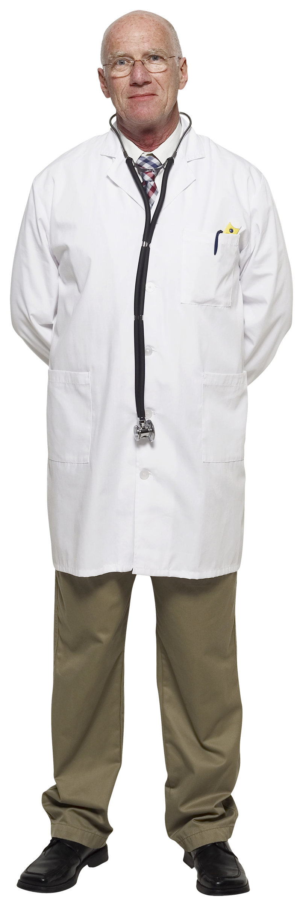
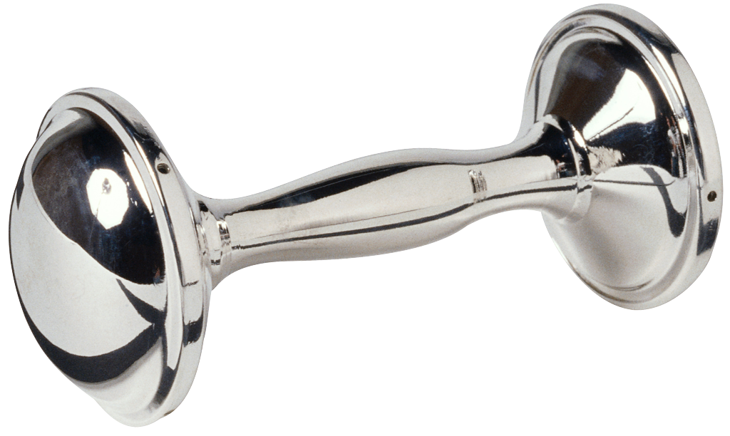
Does Physician Behavior Matter?
Is there a relationship between the personal health habits of physicians and their practices in counseling?
Abramson S, Stein J, Schaufele M, Frates E, Rogan S. Personal exercise habits and counseling practices of primary care physicians: a national survey. Clinical Journal of Sports Medicine. 2000;10(1):40-8.
?
Notes:
This is all well and good for your patients.
What about you?
Do your personal behaviors matter?
I wondered this as a resident.
With colleagues we polled internal medicine physicians.

Slide 11
Results
Physicians who exercise are more likely to counsel their patients to exercise.
Those that do aerobic training counsel on aerobic training, and those that do strength training counsel on strength training.
The main barriers to counseling on exercise were
inadequate time
lack of knowledge/experience with exercise counseling
Abramson S, Stein J, Schaufele M, Frates E, Rogan S. Personal exercise habits and counseling practices of primary care physicians: a national survey. Clinical Journal of Sports Medicine. 2000;10(1):40-8.
Notes:
We found that
Physicians who exercise are more likely to counsel on exercise.
More specifically—physicians who do aerobic training are more likely
To counsel on aerobic training and physicians who strength train are
More likely to counsel on strength training.
The main barriers were time and lack of knowledge.

Slide 12
Coaching Conversations in Lifestyle Medicine
Collaborating with a patient through coaching conversations differs from telling a patient what to do with direct advice.

Slide 13
5 A’s of behavior change counseling: Agree is Key
5 As
Assess
Advise
Agree
Assist
Arrange
US Preventive Services Task Force Recommendations
http://www.uspreventiveservicestaskforce.org/3rduspstf/behavior/behsum2.htm

Slide 14
Core Competencies— In Lifestyle Medicine
9. Establish effective relationships with patients and families to effect and sustain behavioral change using evidence-based counseling methods and tools and follow up.
10. Collaborate with patients and their families to develop evidence-based, achievable, specific, written action plans such as lifestyle prescriptions.
11. Help patients manage and sustain healthy lifestyle practices, and refer patients to other health care professionals as needed for lifestyle-related conditions.
Lianov L, Johnson M. Physician Competencies for Prescribing Lifestyle Medicine. JAMA. 2010;304(2):202-203.

Slide 15
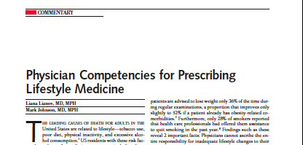
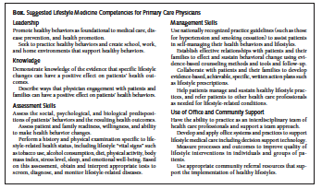
Lifestyle Medicine Competencies
Notes:
This is one of those landmark articles in our field
Published two years ago.
The reference is listed in your handout.
This will be a good tool for you to utilize when
You get back to your office and you want to try to
Explain lifestyle medicine to your colleagues..

Slide 16
Table 1 in Coaching for Behavior Change in Physiatry-
Coach
Vs.
Expert
Helps patients help themselves
Builds motivation, conﬁdence, and engagement
Relies on patient self-awareness and insights
Strives to help patients ﬁnd their own answers
Focuses on what is working well
Collaborates
Treats patients
Educates
Relies on skills and knowledge of expert
Strives to have all the answers
Focuses on the problem
Advises
Frates et al. Am. J. Phys. Med. Rehabil. & Vol. 90, No. 12, December 2011

Slide 17
COACH™ Approach Described and published in American Journal of Lifestyle Medicine 2016
C = Curiosity
O = Openness
A = Appreciation
C = Compassion
H = Honesty
Frates EP, Bonnet JP. Collaboration and Negotiation: The Key to Therapeutic Lifestyle Change. Am. J. Lifestyle Med. Accepted for publication 2016 Jan.
Frates EP, Bonnet JP: Behavior Change in Nutrition Counseling. In: Rippe, JM, editor. Nutrition in Lifestyle Medicine. 1st ed. Springer;2016.

Slide 18
Five-Step Cycle in the Coaching Model
Frates EP, Moore MA, Lopez CN, et al. Coaching for behavior change in physiatry. Am J Phys Med Rehabil. 2011;90(12):1074-82.

Slide 19
Examples of Randomized Controlled Trials on Coaching in Healthcare
Study | Number of subjects | Primary Outcomes
Vale et al. | 792 patients with cardiac disease | Chol. drop 21 mg/dL vs. 7 mg / dL (p <.0001)
Whittemore et al. | 53 women with diabetes | Better diet self-management, less diabetes related distress, higher satisfaction with care
Wolever et al. | 56 patients with Type 2 diabetics | Significant reduction in Hemoglobin A1C among subjects with baseline > 7
Fischer et al. | 191 children with asthma (parents and children coached) | Decreased re-hospitalization rate compared to controls 35.6% vs. 59.1% (p<.01)
Oliver et al. | 67 cancer pain patients | Improved pain severity compared to control (p=.014)
Notes:
This slide review 5 sample randomized controlled trials where the coaching specifics are identified.
I would like to review this with you to give you a sense of what is out there in the literature.
One of the studies with the largest number of subjects is the one at the top of the list by Vale and colleagues at in Australia
Who coined the term COACH Intervention—coaching on achieving cardiovascular health-. This study showed that the coach group reduced cholesterol by 21 mg compared to the control group that dropped by 1/3 as much or 7mg.
There are multiple studies with coaching and diabetes. The Whittemore and colleagues from Yale nursing school demonstrated that the coaching group had
Multiple benefits including better diet self management, less diabetes related distress, and higher satisfaction with care.
Ruth Wolever and colleagues in Duke studied 56 type 2 diabetics and showed that the coach group had a significant reduction in hemoglobin A1c compared to subjects in the control group.
Asthma patients---pediatric patients and their parents were coached over a two year period and the main outcome was rates of rehospitalization which has a lare impact on individual patients as well as the entire health care system. Those in the coaching group had a reduced re-hospitalization rate 35.65 compared to 59.1% in control group.
Lastly, I want to point out the study on cancer pain patients who received one 20 minute coaching session prior to seeing their oncologist. Those in this coaching group had improved pain severity compared to control at two week follow up.

Slide 20
The Transtheoretical Model of Change
James Prochaska,
PhD--University of R.I.
Changing for Good with John C. Norcross, PhD and Carlo C. DiClemente, PhD 1994, reprinted 2002, paperback 2006
Stages
Pre-contemplative
Contemplative
Preparation
Action
Maintenance
Termination
Notes:
Now you have seen the importance and the opportunity we all have to help empower patients to adopt healthy lifestyles.
You have a sense of the coach approach and basically know what to do with sharing your knowledge and asking permission, listening whole heartedly,
Asking open ended questions, treating problems like opportunities to learn and grow and finally helping patients take responsibility for their behaviors.
To conclude the lecture, we will look at a specific tool to use on Monday that will help you help your patients tackle behavior change.
It is called the Transtheoretical Model of Change
Dr. James Prochaska at the University of Rhode Island has been working with this model for decades.
As it turns out, his father was an alcoholic and died of his disease at an early age. Dr. Prochaska dedicated his career
To finding out ways to help alcoholics overcome their disease and trying to better understand how to enable them to change.
After developing and testing his model with addiction medicine, he utilized it with other behaviors such as healthy eating and exercise.
It is a tool that the American College of Sports Medicine has adopted and uses in their Exercise is Medicine Campaign.
This approach helps physicians and health care providers target their interventions to meet the needs of their patients.
It revolves around knowing the different stages.
Here are 6 stages
Pre-contemplative
Contemplative
Preparation
Action
Maintenance
Termination-many people argue that there is no termination phase for certain behaviors such as healthy eating and exercising yet there is a termination phase for others such as cigarette smoking. For our purposes, we will discuss the first five stages.

Slide 21
TTM Change
http://sphweb.bumc.bu.edu/otlt/MPH-Modules
/SB/SB721-Models/SB721-Models6.html
http://iknowicanempower.wordpress.com
/2011/06/29/stages-of-change-introduction/

Slide 22
Pre-Contemplation
Resisting Change
Not intending to take action in the foreseeable future
Uninformed
Under informed
http://www.prochange.com/transtheoretical-
model-of-behavior-change
Notes:
Consciousness Raising (Get the Facts).Consciousness raising involves increased awareness about the causes, consequences, and cures for a particular problem behavior. Interventions that can increase awareness include feedback, interpretations, and bibliotherapy. Sedentary people, for example, may not be aware that their inactivity can have the same risk as smoking a pack of cigarettes a day.
Dramatic Relief (Pay Attention to Feelings).Dramatic relief initially produces increased emotional experiences followed by reduced affect or anticipated relief if appropriate action is taken. Interventions can provide fear arousing feedback on health risks or success stories to move people emotionally.
Environmental Reevaluation (Notice Your Effect on Others).Environmental reevaluation combines both affective and cognitive assessments of how the presence or absence of a personal habit affects one’s social environment, such as the effect of smoking on others. It can also include the awareness that one can serve as a positive or negative role model for others.
Self-Reevaluation (Create a New Self-Image).Self-reevaluation combines both cognitive and affective assessments of one’s self-image with and without a particular unhealthy habit, such as one’s image as a couch potato versus an active person. Values clarification, identifying healthy role models, and imagery are techniques that programs can use to move people toward self-reevaluation. During interaction with a TTM intervention, the program might ask, “Imagine you were free from smoking. How would you feel about yourself?
”Social Liberation (Notice Social Trends).Social liberation requires an increase in social opportunities or alternatives, especially for people who are relatively deprived or oppressed. For example, advocacy, empowerment procedures, and appropriate policies can produce increased opportunities for mental health promotion, gay health promotion, and health promotion for impoverished segments of the population. These same procedures can also be used to help populations change; examples include smoke-free zones, healthy food at schools and work, and easy access to condoms and other contraceptives.

Slide 23
The Pre-contemplators
Ask if the patient would like to hear about or read about the benefits of exercise
I understand that you are not ready to exercise, but please know that when you are ready, I will be here to help.
I think that it is important for your health….
Key: Raise awareness and empathy
Notes:
What are these stages
Let’s start with the most interesting and perhaps the most challenging
The Pre-Contemplators
The “I can’t----I won’t”
Has anyone ever had a patient who said—No way, I can’t do it. I have no time
Has anyone said those words themselves?
OK. So what do you do?

Slide 24
Processes for Pre-Contemplation Experiential
Consciousness raising
Give the facts/ identify defenses
Dramatic relief
Use emotion
Environmental reevaluation
Notice the effect of the behavior on others
Social Liberation
Notice public support
Smoke free zones at work, ban on trans fats
Self help groups

Slide 25
Contemplation
Thinking about changing
Intend to change in the next 6 months
Often in this stage for months or years
Ambivalent
Pros vs. Cons
http://www.prochange.com/transtheoretical-
model-of-behavior-change
Notes:
Contemplation is the stage in which people intend to change in the next six months. They are more aware of the pros of changing, but are also acutely aware of the cons. In a meta-analysis across 48 health risk behaviors, the pros and cons of changing were equal (Hall & Rossi, 2008). This weighting between the costs and benefits of changing can produce profound ambivalence that can cause people to remain in this stage for long periods of time. This phenomenon is often characterized as chronic contemplation or behavioral procrastination. Individuals in the Contemplation stage are not ready for traditional action-oriented programs that expect participants to act immediately.
Self-Reevaluation (Create a New Self-Image).Self-reevaluation combines both cognitive and affective assessments of one’s self-image with and without a particular unhealthy habit, such as one’s image as a couch potato versus an active person. Values clarification, identifying healthy role models, and imagery are techniques that programs can use to move people toward self-reevaluation. During interaction with a TTM intervention, the program might ask, “Imagine you were free from smoking. How would you feel about yourself?”

Slide 26
Contemplators
Ask the patient to consider what things would be like if they did not begin an exercise program
Ask the patient to consider what things would be like if they did begin an exercise program
Ask the patient how important exercise is to them
Work with the patient to identify a powerful, intrinsic motivator
Identify a reason with emotional resonance
Key: Vision and Motivators
Notes:
I may, I might, I am thinking about it and thinking about it
Perhaps they have been thinking about it for months or even years—
This is also known as Chronic Contemplation
What can we do for these folks?

Slide 27
Processes for Contemplators- Experiential
Similar to Pre-Contemplation
Add self-reevaluation
Create a new self image
“Imagine you were free from smoking. How would you feel about yourself?”
Connect with core values
Identify healthy role models

Slide 28
Preparation
Intend to take action in the immediate future-usually within the next month
Have a plan
Ready for action oriented programs
http://www.prochange.com/transtheoretical-
model-of-behavior-change
Notes:
Preparation
.Preparation is the stage in which people intend to take action in the immediate future, usually measured as the next month. Typically, they have already taken some significant action in the past year. These individuals have a plan of action, such as joining a health education class, consulting a counselor, talking to their physician, buying a self-help book, or relying on a self-change approach. These are the people who should be recruited for action-oriented programs.
Self-Liberation (Make a Commitment).
Self-liberation is both the belief that one can change and the commitment, as well as the recommitment, to act on that belief. Encouraging people to make New Year’s resolutions, public testimonies, or a contract are ways of enhancing willpower. A TTM program might say, “Telling others about your commitment to take action can strengthen your willpower. Who are you going to tell?”
Counter Conditioning (Use Substitutes).Counter conditioning requires learning healthy behaviors as substitutes for problem behaviors. Examples of counter conditioning include recommendations for use of nicotine replacement as a safe substitute for smoking or walking as a healthier alternative than “comfort foods” as a way to cope with stress.
Helping Relationships (Get Support).Helping relationships combine caring, trust, openness, and acceptance, as well as support for healthy behavior change. Rapport building, a therapeutic alliance, supportive calls, and buddy systems can be sources of social support.

Slide 29
The People in Preparation
Ask the patient how confident she is in her ability to perform exercise
Ask how the patient can increase her confidence in her ability to perform exercise
Develop a SMART exercise goal for the patient
Identify possible obstacles and brainstorm strategies around them
Key: A solid plan with SMART goals
Notes:
These people are ripe but just not quite ready.
How do we get them to take the leap?

Slide 30
Processes for Preparation- Behavioral
Commitment/ Self-liberation
Make a commitment
“Who are you going to tell?”
Counter conditioning/ Substitutions
Jog instead of drink
Eat apples instead of chips and crackers at night
Helping relationships

Slide 31
Strategies for Preparation
Discuss options that will work (client ideas)
Egger—ABC’s
ACT-set a time and date-have a plan
BELONG-find a support buddy
COMMIT-write the SMART goal down, set up accountability
Continue to tap into intrinsic motivation
Egger at al. Chapter 4

Slide 32
Action
Have made changes in past six months.
http://www.prochange.com/transtheoretical-
model-of-behavior-change
Notes:
Action.
Action is the stage in which people have made specific overt modifications in their lifestyles within the past six months. Because action is observable, the overall process of behavior change often has been equated with action. But in the TTM, Action is only one of six stages. Typically, not all modifications of behavior count as Action in this Model. In most applications, people have to attain a criterion that scientists and professionals agree is sufficient to reduce risk of disease. For example, reduction in the number of cigarettes or switching to low-tar and low-nicotine cigarettes were formerly considered acceptable actions. Now the consensus is clear—only total abstinence counts.
Reinforcement Management (Use Rewards).
Reinforcement management provides consequences for taking steps in a positive direction. While reinforcement management can include the use of punishment, self-changers rely on reward much more than punishment. So, the TTM recommends an emphasis on reinforcement so as to work in harmony with how people change naturally. People expect to be reinforced by others more frequently than occurs, so they should be encouraged to reinforce themselves through self-statements like “Nice going—you handled that temptation.” They also need to treat themselves at milestones as a way to provide reinforcement and to increase the probability that healthy responses will be repeated.
Stimulus Control (Manage Your Environment).
Stimulus control removes cues for unhealthy habits and adds prompts for healthier alternatives. In this process TTM programs can recommend removing all the ashtrays from the house and car or removing high-fat foods that are tempting cues for unhealthy eating.

Slide 33
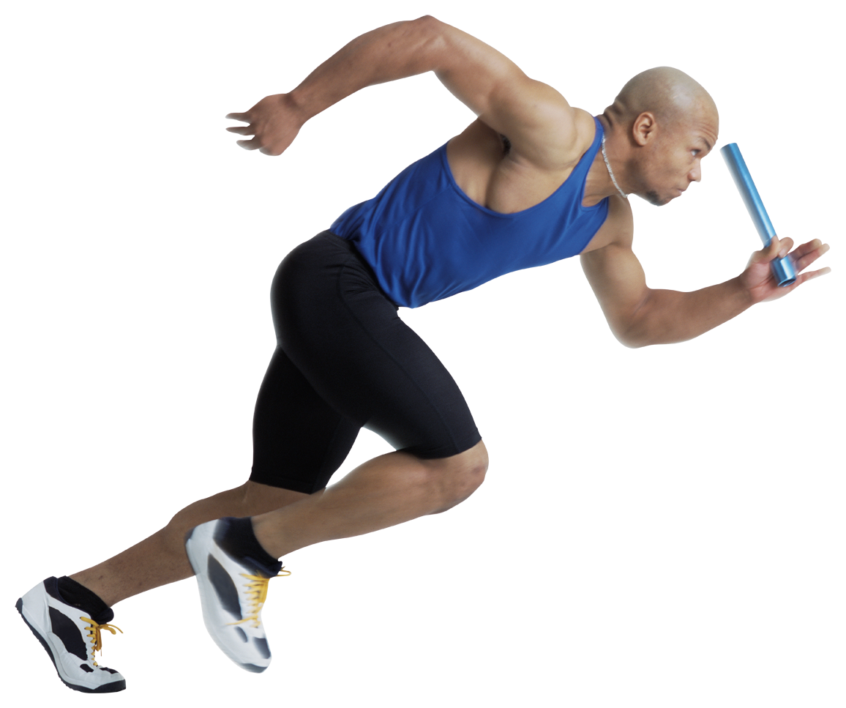
The People in Action
Review physical activity guidelines
Write an exercise prescription
Follow up on the patient’s progress
Congratulate patients on their exercise
Encourage patients to meet the guidelines
Ask about walks or runs for non-profits (AHA)
Key: Motivators, rewards, goals
Notes:
This is an easy stage to ignore.
Well, they are doing it, they made the change and have been doing it for 3-6 months
But remember this ---every stage needs careful attention---even action
Congratulating the patient and showing them concrete data like Cholesterol, BP, resting HR rate, weight, fitness measures like a timed mile
Or pedometer.
Reviewing the guidelines and asking if the patient wants to increase time or frequency to try to reach the guidelines and maximize health benefits.
Another possibility for this group is to see if they are interested in a walk or run for charity or research.

Slide 34
Processes for Action-Behavioral
Helping Relationships- like preparation
Counter conditioning- like preparation
Reinforcement Management
Use Rewards
Self-statements “Nice going!”
Environmental Control (stimulus control)
Manage your environment
Remove unhealthy cues
Add prompts for healthy alternatives

Slide 35
Maintenance
Have already made significant changes in lifestyle for more than 6 months
Try to prevent relapse
http://www.prochange.com/transtheoretical-
model-of-behavior-change
Notes:
Maintenance.
Maintenance is the stage in which people have made specific overt modifications in their lifestyles and are working to prevent relapse; however, they do not apply change processes as frequently as do people in Action. While in the Maintenance stage, people are less tempted to relapse and grow increasingly more confident that they can continue their changes. Based on self-efficacy data, researchers have estimated that Maintenance lasts from six months to about five years. While this estimate may seem somewhat pessimistic, longitudinal data in the 1990 Surgeon General’s report support this temporal estimate. After 12 months of continuous abstinence, 43% of individuals returned to regular smoking. It was not until 5 years of continuous abstinence that the risk for relapse dropped to 7% (USDHHS).

Slide 36
The People in Maintenance
Discuss the patients exercise routine
Consider recommending cross training
Review health benefits with patient
Congratulate patient
Write an exercise prescription
Recommend becoming a mentor to family or friends
Key: Motivators, rewards, goals +
variety and mentoring
Notes:
This is another important stage.
As I mentioned people in maintenance can slip into contemplation depending on the circumstances in their lives.
Thus, it is important to engage in conversation about exercise even with those in maintenance.
You might recall when I started this lecture I brought up an example from my own doctor’s appointment.
I would like to revisit that appointment again.
During that appointment, while in my Johnny, my physician started asking me a series of questions, while looking at the computer screen and typing in responses. Surely most of these were closed ended. She said, --So you are still exercising 5 days a week I am sure---
“Well, I said with a little embarrassment, yes but things got really busy this fall and I found that a half an hour run at a vigorous intensity was all I could manage even though… Then, she interrupted me and said—”But it is 5 days a week right?” I agreed and she plugged in the number 5. To be honest, I wanted to talk about my changing exercise routine, but I never got the chance. Maintenance exercisers may also have concerns and it is important to engage them in conversation, congratulate them, and check in on their plans for the next season etc.

Slide 37
Processes for Maintenance
Helping relationships
Counter conditioning
Reinforcement management
Environmental control/ stimulus control

Slide 38
Termination
Not tempted
100% self-efficacy
Automatic habit
Seatbelt use
Take anti-hypertensives
For exercise, smoking cessation, alcohol abstinence, healthy eating and weight management, it might be a lifetime of maintenance.
http://www.prochange.com/transtheoretical-
model-of-behavior-change
Notes:
Termination.
Termination is the stage in which individuals are not tempted; they have 100% self-efficacy. Whether depressed, anxious, bored, lonely, angry, or stressed, individuals in this stage are sure they will not return to unhealthy habits as a way of coping. It is as if their new behavior has become an automatic habit. Examples include adults who have developed automatic seatbelt use or who automatically take their antihypertensive medication at the same time and place each day. In a study of former smokers and alcoholics, researchers found that less than 20% of each group had reached the criteria of zero temptation and total self-efficacy (Snow, Prochaska & Rossi, (1992). The criterion of 100% self-efficacy may be too strict or it may be that this stage is an ideal goal for population health efforts. In other areas, like exercise, consistent condom use, and weight control, the realistic goal may be a lifetime of maintenance.

Slide 39
A tool to help practitioners meet the needs of patients/clients.
http://www.prochange.com/transtheoretical-model-of-behavior-change

Slide 40
Resources
Books:
Changing For Good: A Revolutionary Six-Stage Program for Overcoming Bad Habits and Moving Your Life Positively Forward
James O. Prochaska
Motivational Interviewing: Helping People Change
William R. Miller and Stephen Rollnick
Papers:
Frates EP, Bonnet JP. Collaboration and Negotiation: The Key to Therapeutic Lifestyle Change. American Journal of Lifestyle Medicine. Accepted for publication 2016 Jan.
Frates EP, Moore MA, Lopez CN, McMahon GT. Coaching for behavior change in physiatry. American Journal of Physical Medicine and Rehabilitation. 2011;90(12):1074-82.
Textbooks:
Nutrition in Lifestyle Medicine (James Rippe editor)
Chapter: Behavior Change in Nutrition Counseling
Elizabeth Frates, Jonathan Bonnet

Slide 41
Become Part of the LM Movement!
Join the American College of Lifestyle Medicine (ACLM) and connect with others passionate about LM!
Plus, tons of additional membership benefits!
For trainees, we encourage you to become a Professional in Training (PiT) member and get involved in spreading LM to campuses nationwide!
Lifestyle Medicine Interest Group (LMIG) Starter Kit and Introductory Video available online
www.lifestylemedicine.org
Notes:
Hyperlink 1: http://www.lifestylemedicine.org/Membership-Application
Hyperlink 2: http://www.lifestylemedicine.org/Membership-Benefits
Hyperlink 3: http://www.lifestylemedicine.org/Why-Join
Hyperlink 4: http://www.lifestylemedicine.org/INTEREST-GROUPS
Hyperlink 5: https://vimeo.com/143219257

Slide 42
Interested in Diving Deeper into LM and Advancing the Field?
There is a special award for Professionals in Training.
The Donald Anderson Pegg Award to help start your own LMIG at a medical school or to help spread LM in another health care related professional school.
Please go to the ACLM website for further information.
Teams of students can apply and attendings/mentors are encouraged to get involved as well.
www.lifestylemedicine.org
Notes:
Hyperlink 1 & 2: http://www.lifestylemedicine.org/Annual-Awards#DonaldAndersonPeggAwardforYoungLifestyleMedicineInnovators

Slide 43
Join Us!
The Lifestyle Medicine Conferences are a great way to get connected with other healthcare professionals that are passionate about improving the lives of others through lifestyle medicine!
Come connect with colleagues and hear from LM visionaries to learn about current, evidence-based LM practices.
LMConference.org
Notes:
Hyperlink 1: lmconference.org

Slide 44
Special thanks…
…to the American College of Lifestyle Medicine and to ACLM’s Professionals in Training (PiT) for their support.

